Slide 1
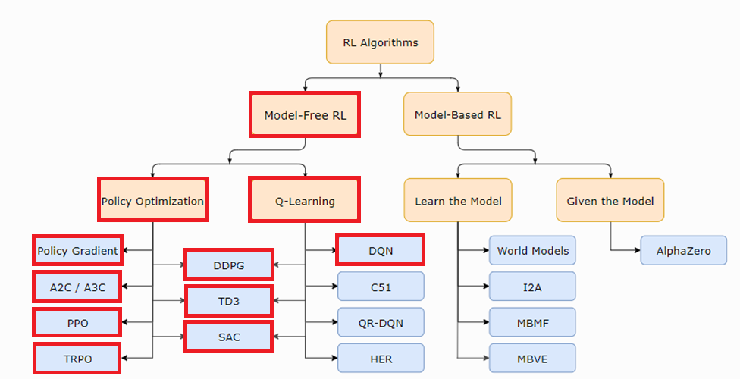
Getting started with RL
Szilárd Kósa, https://github.com/SzilardKosa/RLProject

Slide 2
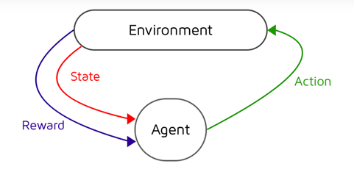
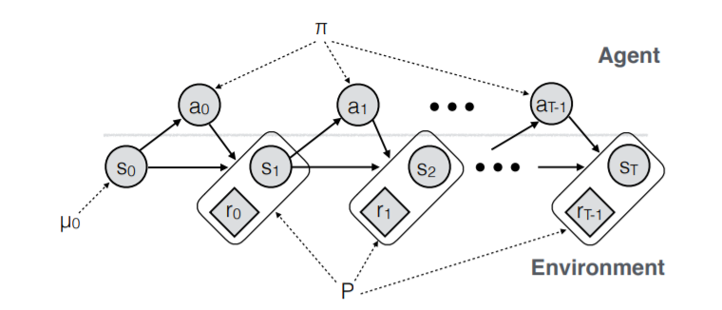

Markov decision process
The agent receives a state
The agent takes an action
The state of the environment changes
and the agent gets a reward
2. 3. 2. 3. ...

Slide 3

Markov decision process

Slide 4
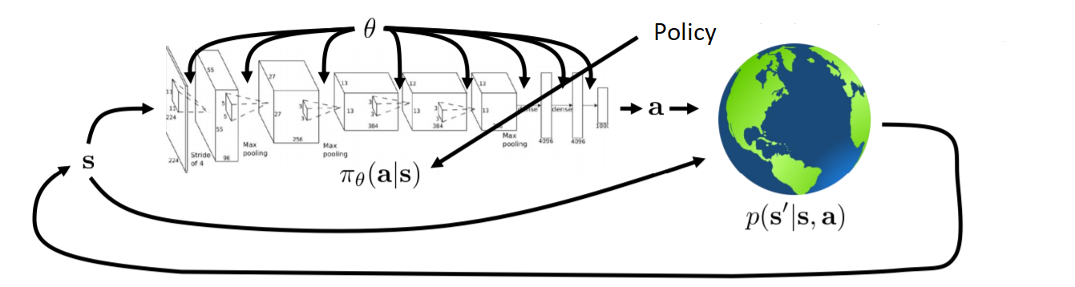
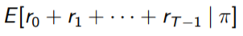

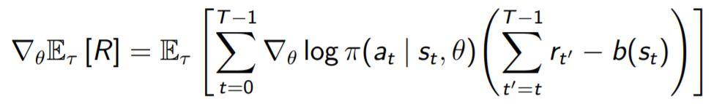
Policy Optimization
The goal is to maximize:
First we collect a whole trajectory:
Then we use policy gradient ascent:

Slide 5
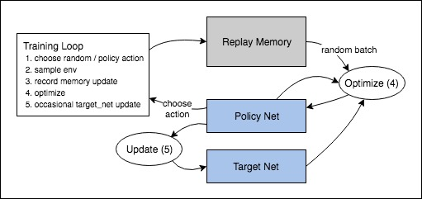
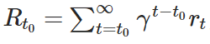
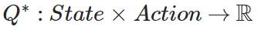
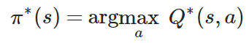
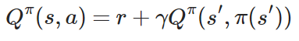
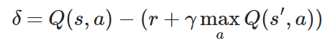
Q-Learning
The goal is to maximize:
If we had:
Then:
Every Q function for some policy obeys the Bellman equation:
We collect ('state', 'action', 'next state', 'reward') data in the Replay Memory.
Then we use gradient descent:

Slide 6
Policy-Based
vs
Value Based
policy-based methods have better convergence properties
policy gradients are more effective in high dimensional action spaces, or when using continuous actions
policy gradient can learn a stochastic policy
lot of the time, policy-based methods converge on a local maximum rather than on the global optimum
value based methods are more sample efficient and steady

Slide 7
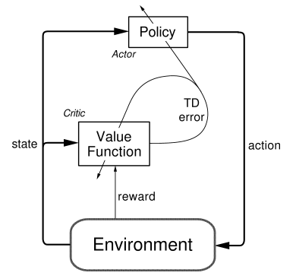
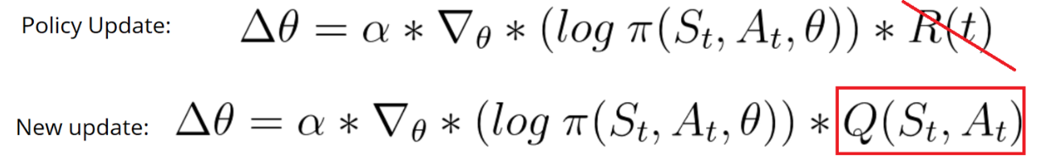
Actor-Critic
Actor: computes an action based on a state
Critic: produces the Q values of the action

Slide 8
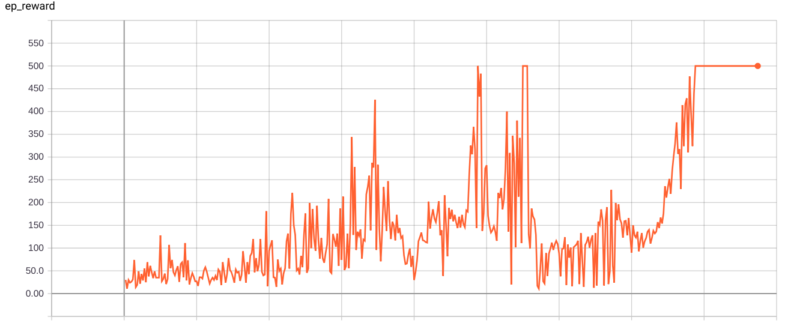
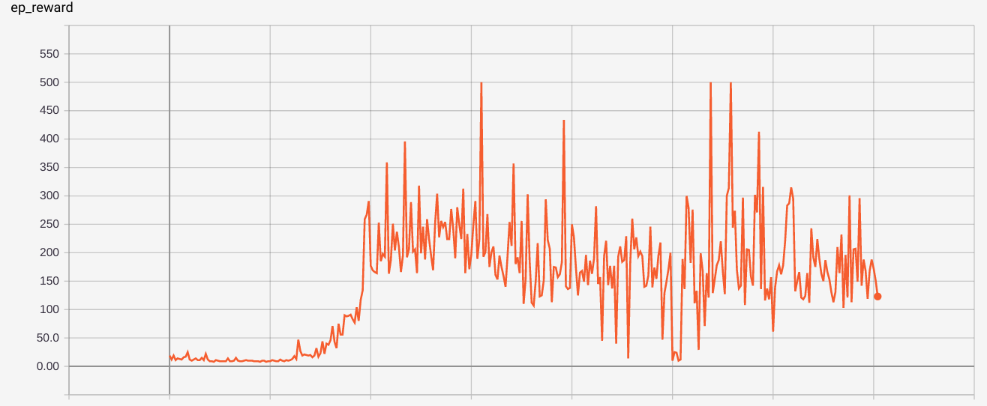
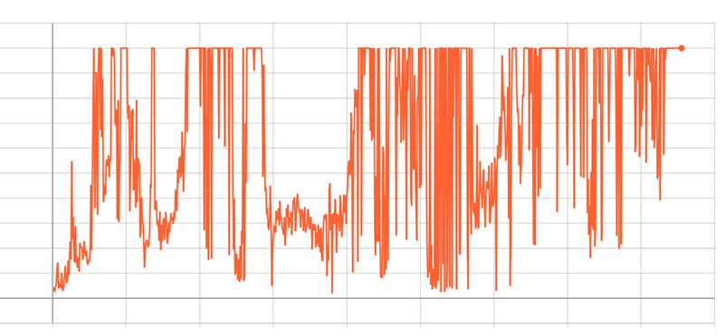
Tensorboard
Reward/Episode
500
VPG
100
200
300
400
System parameters:
Ubuntu 16.04
GeForce GTX 1050
Episode
Reward/Episode
500
DQN
100
200
300
400
Episode
Reward/Episode
500
Actor-Critic
200
400
600
800
Episode

Slide 9
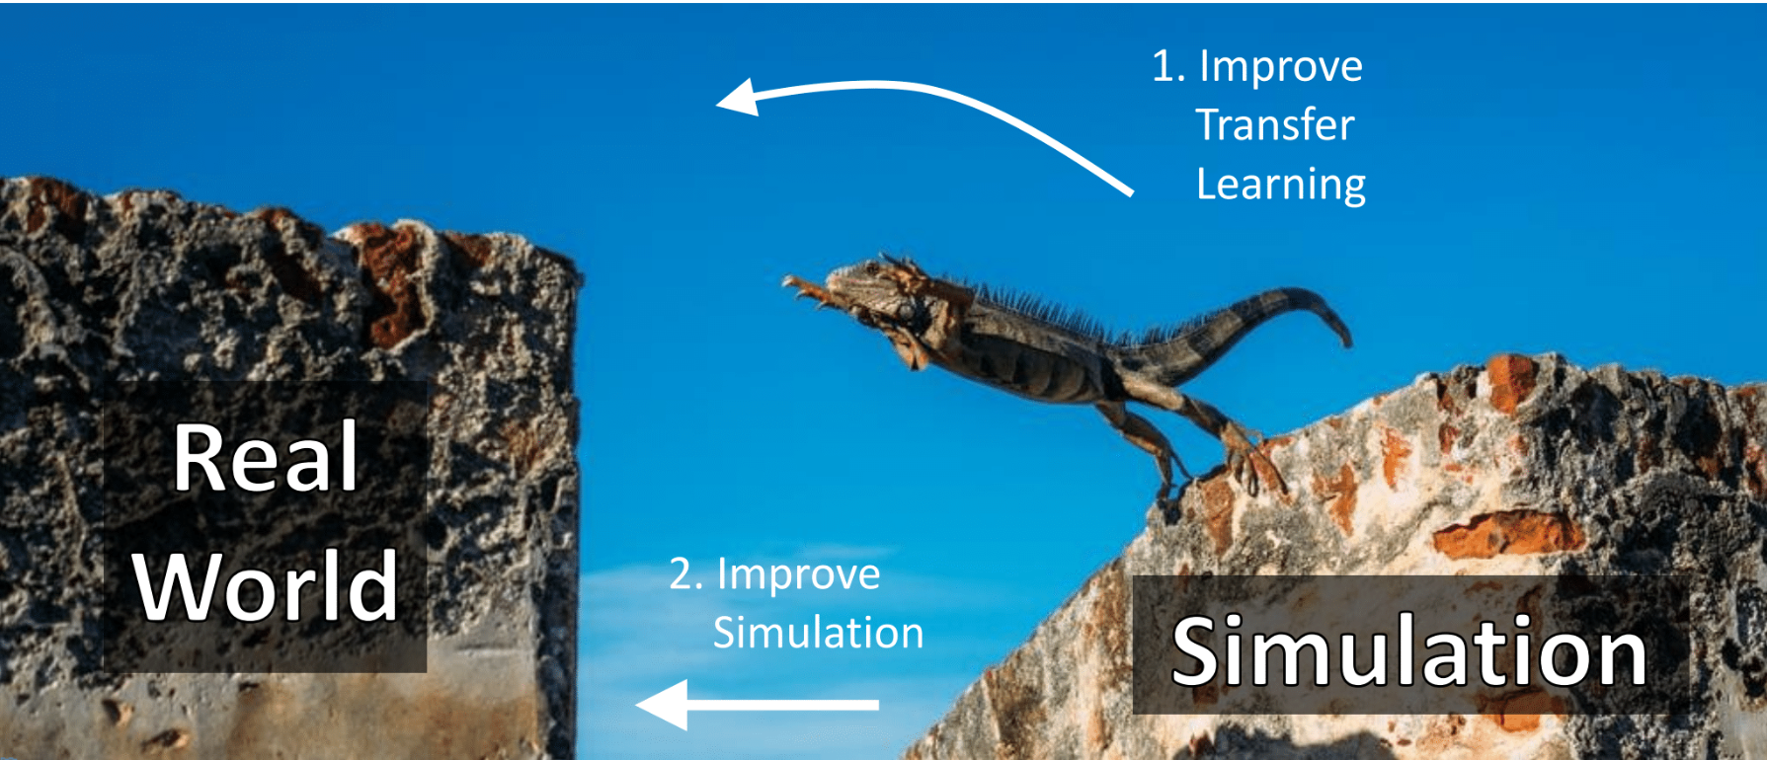
The Challenge for RL in Real World Applications

Slide 10

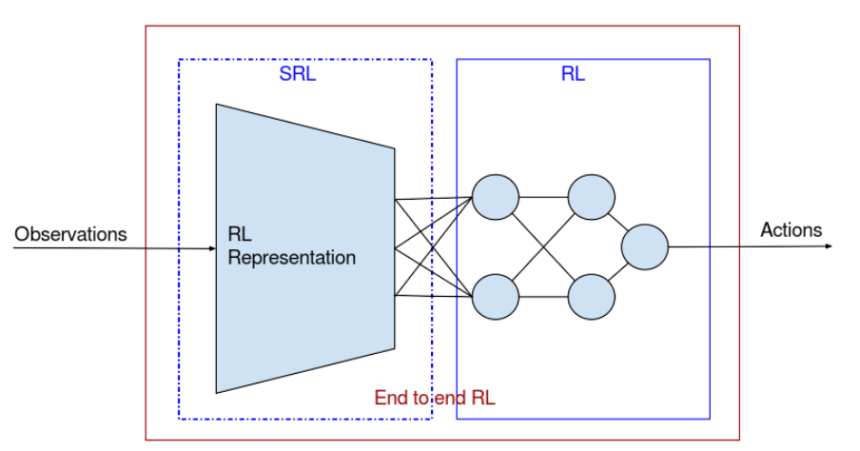
Learning to Drive Smoothly in Minutes
State representation with VAE
Best RL model SAC
Donkey Car simulator (with Unity)

Slide 11
Wayve.ai Approach

Slide 12
Plans for the next two weeks and beyond
Running the code from the previous article
Analysing the SAC algorithm

